Slide 1
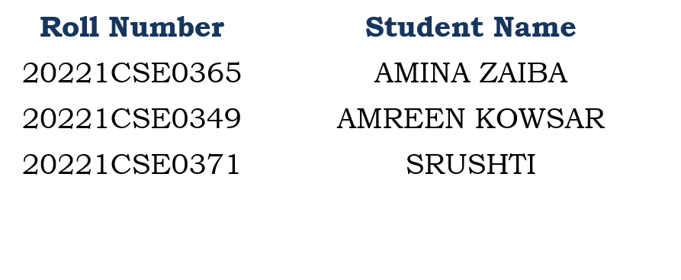
Student Innovation :
“Interactive Smart Education Portal with Aptitude Quizzes, and Memory Games”
CSE7101- Capstone Project
Review-1
Batch Number: CSE_107
Under the Supervision of,
Ms. Kalpana K Harish
Assistant Professor,
School of Computer Science and Engineering
Presidency University
Name of the Program: CSE
Name of the HoD: Dr. Asif Mohammed
Name of the Program Project Coordinator: Dr. Jayavadivel Ravi
Name of the School Project Coordinators: Dr. Sampath A K , Dr. Geetha A

Slide 2
Problem Statement Number: PSCS_240
Organization: AICTE, MIC-Student Innovation
Category : Software
Problem Description: Smart Education, a Concept that Describes learning in digital age.it enables learner to learn more effectively, efficiently, flexibly and comfortably.

Slide 3
Content
Problem Statement
Objectives
Background and Related work for title Selection
Analysis of Problem Statement
Innovation or Novel Contributions
Git-hub Link
Timeline of the Project
References

Slide 4
Objectives
Create a fun and engaging web app for children’s learning.
Use only HTML, CSS, and JavaScript.
Make it ad-free, easy to use, and work on any device.
Combine aptitude quizzes and memory games in one platform.

Slide 5
Background and Related work for title Selection
Smart Education uses technology to make learning easier, faster, and more interesting.
Popular platforms like Byju’s, Quizizz, and Lumosity focus on either academic quizzes or games.
Many existing tools need payment, internet, or separate apps for different skills.
Our project combines aptitude learning and memory games in one free, browser-based platform.

Slide 6
Analysis of Problem Statement
User Perspective:
Target users: Children aged 8–14.
Need: Fun, interactive, and ad-free learning.
Problem: No single free platform that mixes aptitude quizzes and memory games.
Technical Perspective:
Challenge: High interactivity without using frameworks.
Solution: Use HTML, CSS, and JavaScript for all features.
Store progress using LocalStorage for offline use.
Ensure responsive design for mobile, tablet, and desktop.

Slide 7
Analysis of Problem Statement
Technology Stack Components:
HTML5 – Structure of pages.
CSS3 – Styling, colors, and animations.
JavaScript (ES6) – Quiz logic, game controls, and adaptive difficulty.
Local Storage – Save scores and progress offline.
Images/Audio – For visuals and engagement.

Slide 8
Analysis of Problem Statement (contd...)
Software Requirements:
Any modern web browser (Chrome, Firefox, Edge).
Runs locally or online without extra software.
Lightweight for quick loading.
Hardware Requirements:
Minimum: 2 GB RAM, Dual-core processor.
Works on laptop, tablet, or smartphone.
Supports touch, keyboard, and mouse input.

Slide 9
Innovation or Novel Contributions
Puzzle-based login to make sign-in fun and interactive.
Surprise brain boosters between quiz rounds to keep learners active.
Adaptive difficulty that changes based on the student’s performance.
Offline progress saving using Local Storage.
Custom quiz creation option for parents and teachers without coding.

Slide 10
Github Link
Github Link:
https://github.com/capstoneteam107/capstone107.git

Slide 11
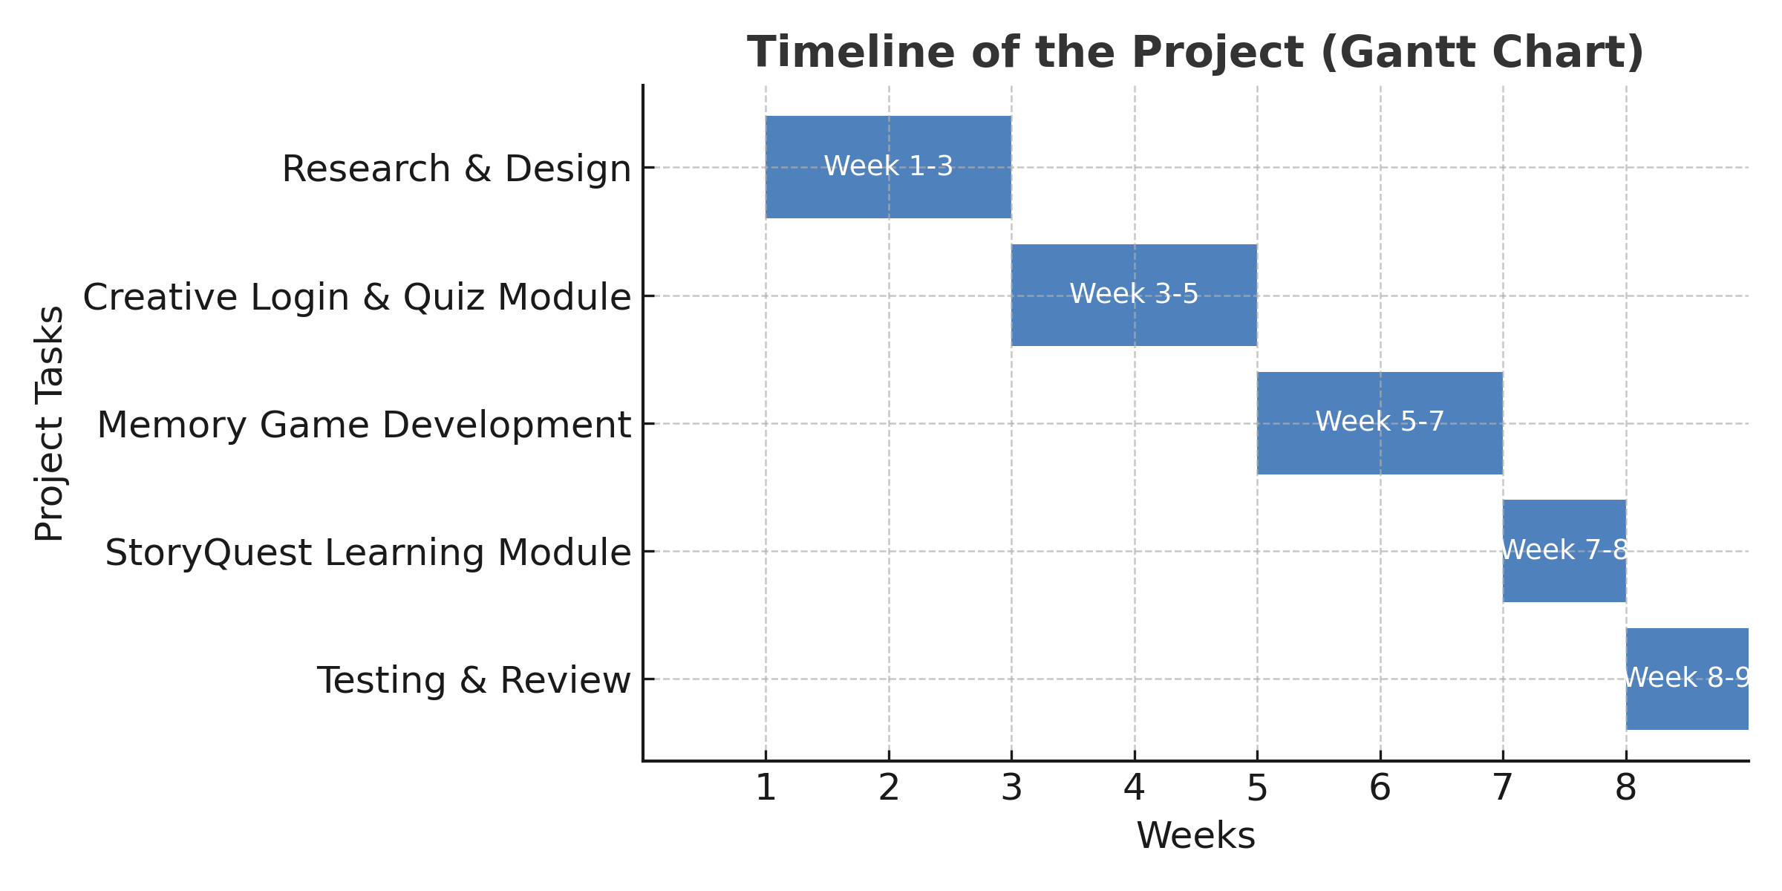
Timeline of the Project (Gantt Chart)

Slide 12
References (IEEE Paper format)
Cook, D. A. (2007). Web-based learning: pros, cons and controversies. Clinical Medicine, 7(1), 37-42
Vlachopoulos, D., & Makri, A. (2017). The effect of games and simulations on higher education: a systematic literature review. International Journal of Educational Technology in Higher Education, 14(1).
Kefalis, C., & Drigas, A. (2019). Web Based and Online Applications in STEM Education. International Journal of Engineering Pedagogy, 9(4), 123-135
Drigas, A., & Karyotaki, M. (2016). Online and other ICT-based Training Tools for Problem-solving Skills. International Journal of Interactive Mobile Technologies, 11(6).

Slide 13


